Slide 1
SEIS 631

Slide 2
t distribution for the difference of two means

Slide 3
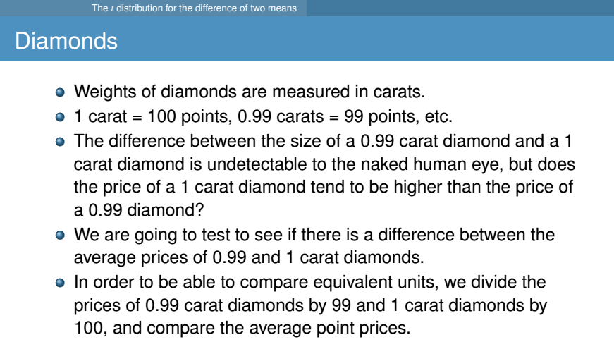

Slide 4
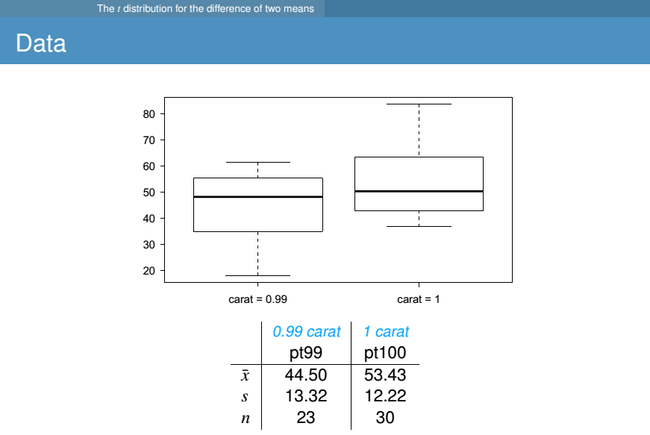

Slide 5

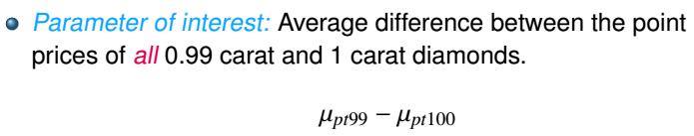
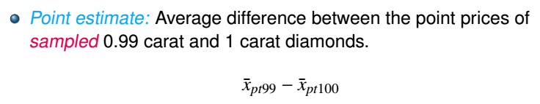

Slide 6
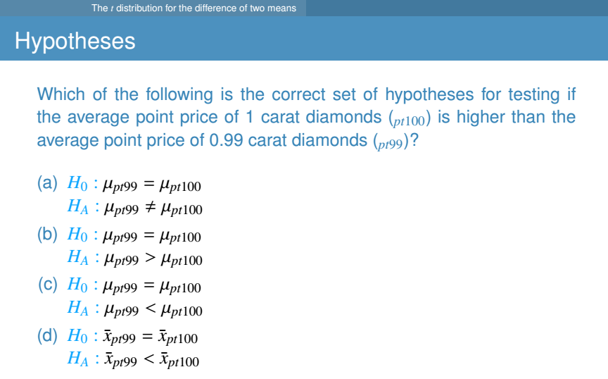

Slide 7
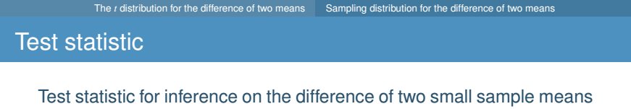
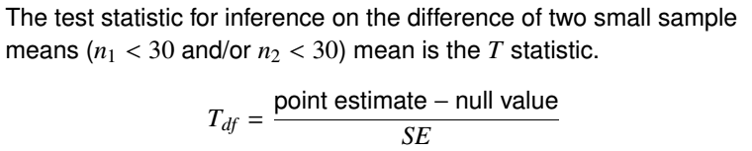
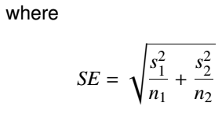
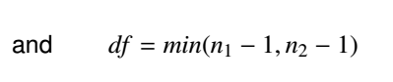
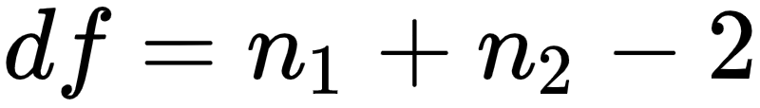
Assuming the variances of
the samples are about the same.
Note: There is an alternative formula for the SE based on the “pooled” variance which gives a better estimate of the SE when the variances can be assumed to be roughly equal. If variances are assumed not equal, the df calculation is more complicated. The t.test() function in R will apply the correct formula if you indicate your assumption on the variances

Slide 8
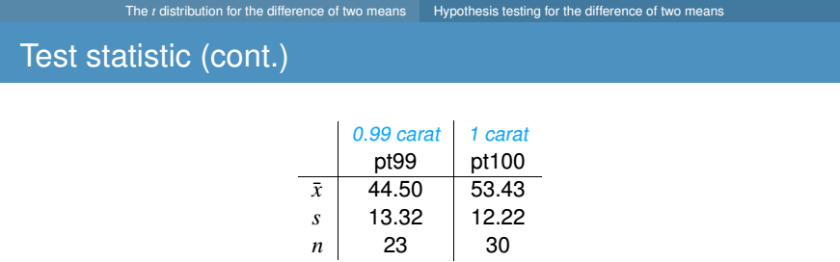
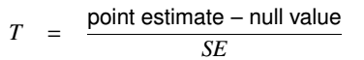
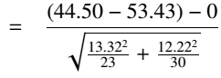
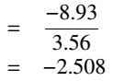

Slide 9
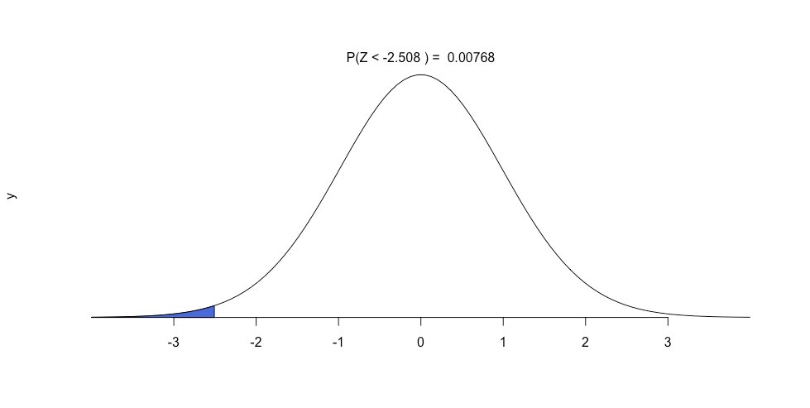
p-value
With T=-2.508, and df = 51 how do we find the p-value?
> pt(-2.508,51)
[1] 0.007682698

Slide 10

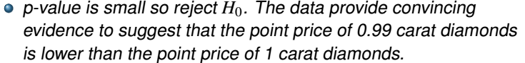

Slide 11
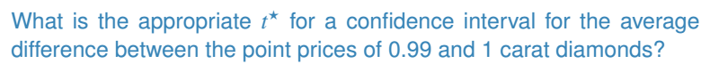
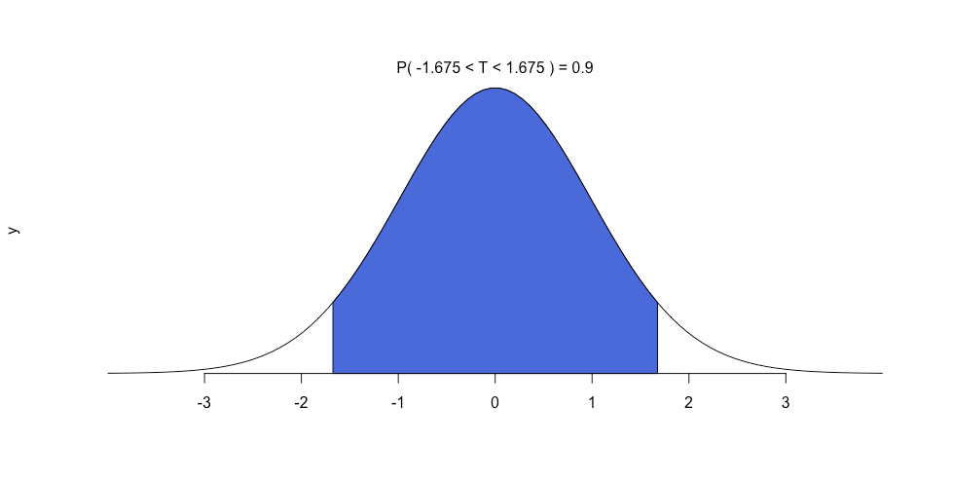
Building a 90% CI
> qt(0.05,51)
[1] -1.675285
> qt(0.05, 51, lower.tail = F)
[1] 1.675285

Slide 12
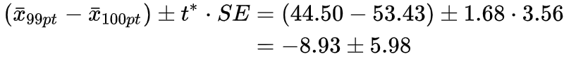
Calculating the Confidence Interval
point estimate ± ME
point estimate ± t* · SE
(-14.91, -2.95)
We are 90% confident that the average point price of a 0.99 carat diamond is $14.91 to $2.95 lower than the average point price of a 1 carat diamond.

Slide 13
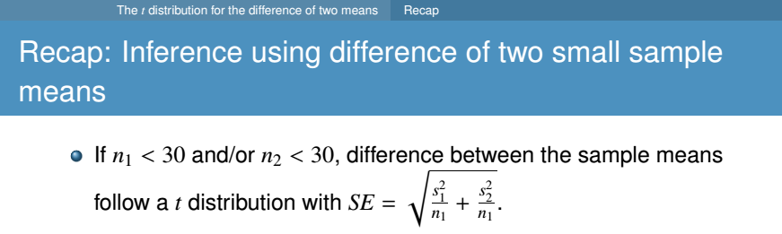
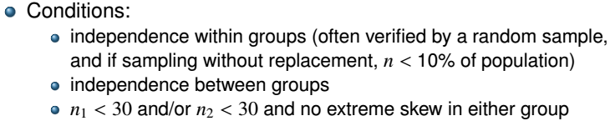
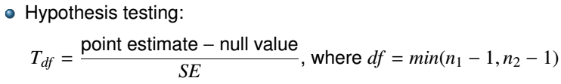
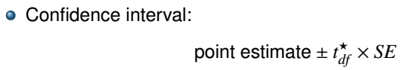
df = n1 + n2 - 2

Slide 14
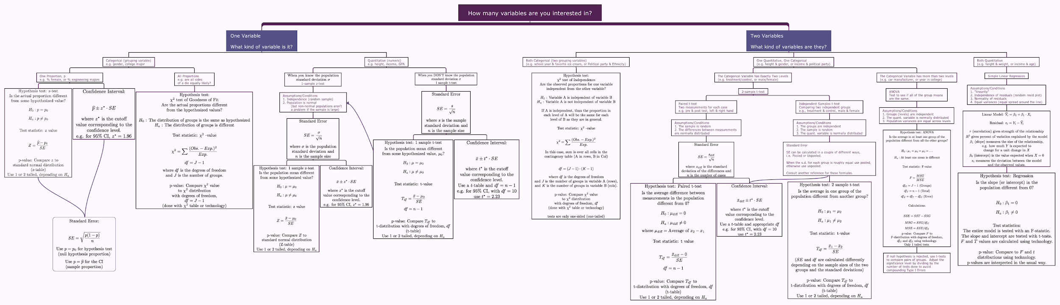

Slide 15
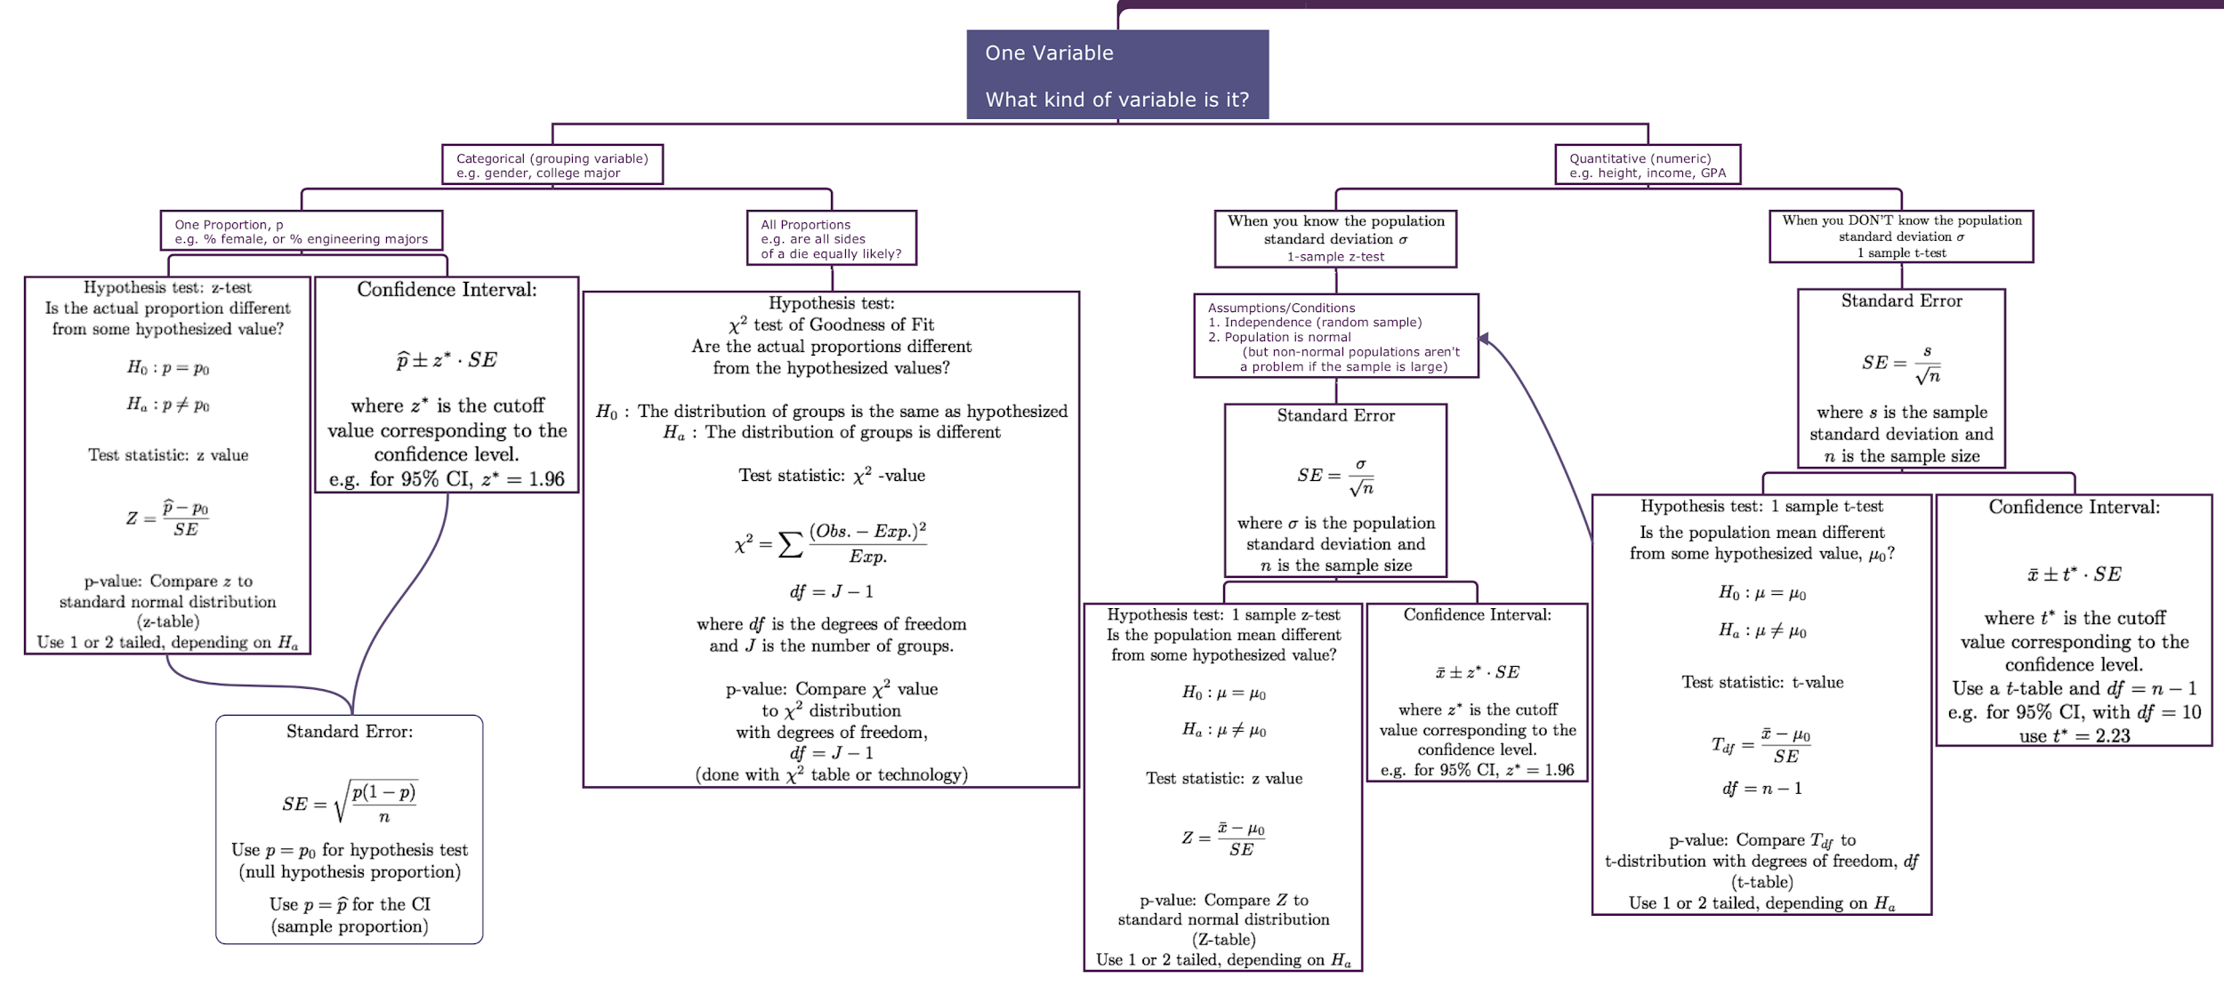

Slide 17
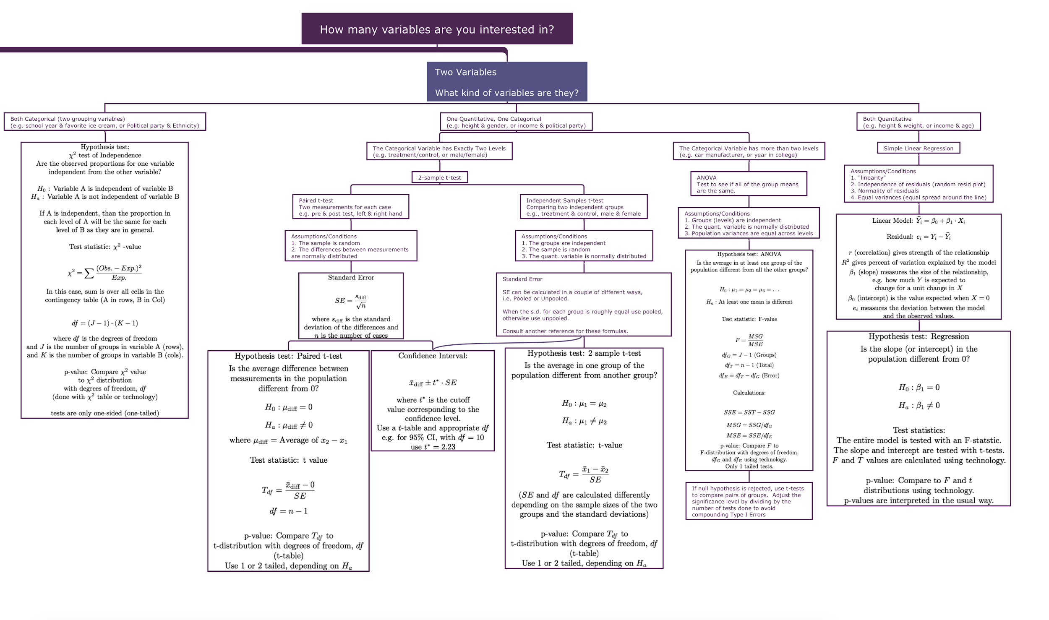

Slide 21
Analysis of Variance (ANOVA)
We know how to compare the means of two groups, but what if there are more than 2 groups?

Slide 22
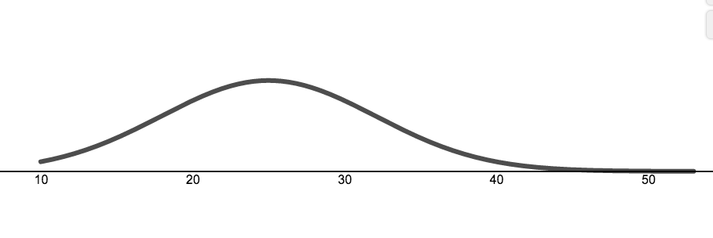
Joe’s Used Car Dealership
Lots of used and new cars.
You are interested in the fuel efficiency of the cars. Specifically, if you picked a random car from the lot what fuel efficiency would you expect, and how much variation would you expect (i.e. how good is your guess).
Here is some information:
Worst on the lot: 10 mpg
Best on the lot: 53 mpg
Average 25 mpg
What’s your guess and how good do you feel about it?
mpg

Slide 23
Joe’s Used Car Dealership
Now we’ll group the cars and see if that helps us guess the fuel efficiency of the random car with more confidence.
First we’ll group by color.

Slide 24


Joe’s Car Dealership
Fuel Efficiency (mpg) broken down by color
Color | Avg | Min | Max
Red | 23 | 10 | 46
Blue | 25 | 11 | 44
Grey | 26 | 10 | 53
What’s your guess and how good do you feel about it?
mpg

Slide 25
Joe’s Car Dealership
Fuel Efficiency (mpg) broken down by color
Color | Avg | Min | Max
Red | 23 | 10 | 46
Blue | 25 | 11 | 44
Grey | 26 | 10 | 53
The color of the car does not provide useful information about the fuel efficiency.
Color and Fuel efficiency are likely unrelated, i.e. independent.
mpg

Slide 26
Joe’s Used Car Dealership
Now we’ll group the cars and see if that helps us guess the fuel efficiency of the random car with more confidence.
First we’ll group by color.
NOT USEFUL INFORMATION
Next we’ll group by Vehicle Type

Slide 27

Joe’s Car Dealership
Fuel Efficiency (mpg) broken down by Type of Vehicle
Type | Avg | Min | Max
SUV | 19 | 10 | 35
Car | 30 | 18 | 53
Pickup | 15 | 10 | 28
What’s your guess and how good do you feel about it?
mpg

Slide 28
Joe’s Car Dealership
Fuel Efficiency (mpg) broken down by Type of Vehicle
Type | Avg | Min | Max
SUV | 19 | 10 | 35
Car | 30 | 18 | 53
Pickup | 15 | 10 | 28
The Type of Vehicle does provide useful information about the fuel efficiency.
Vehicle Type and Fuel efficiency are likely related, i.e. dependent.
mpg

Slide 29
ANOVA
If you are interested in a quantitative variable (i.e. fuel efficiency) does knowing what group a case is in for some grouping variable (i.e. color or vehicle type) provide useful information?

Slide 30
ANOVA Applet
https://www.desmos.com/calculator/up8hj7auxx

Slide 31
ANOVA Example

Slide 32

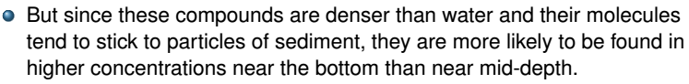

Slide 33
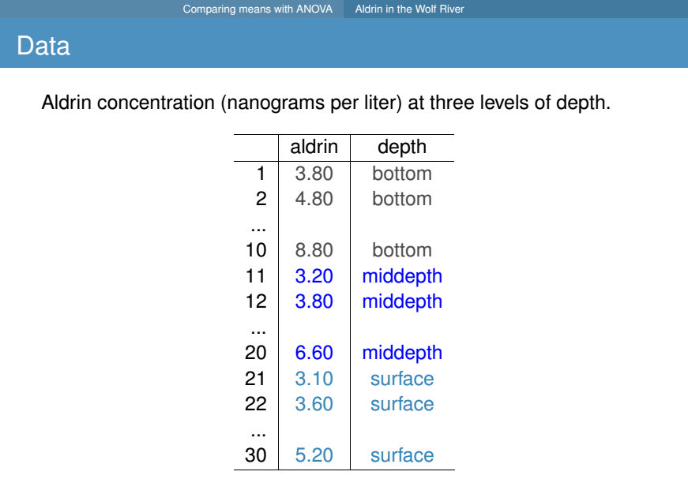

Slide 34
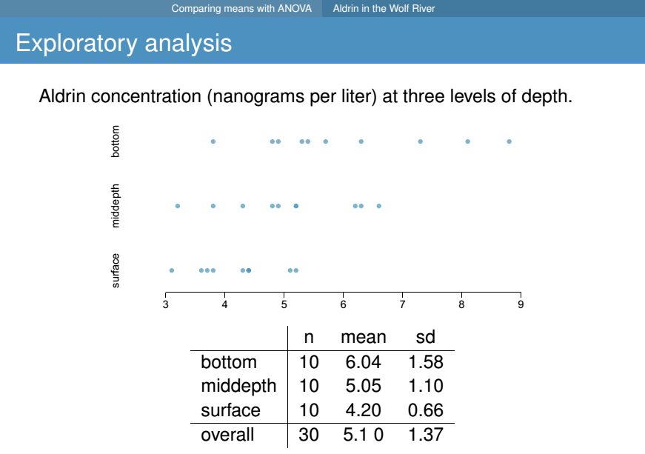

Slide 35
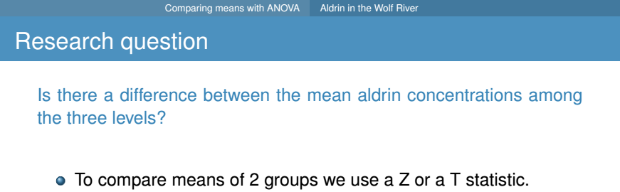


Slide 36
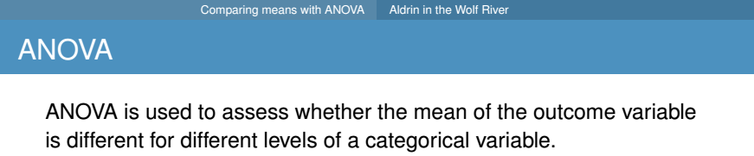
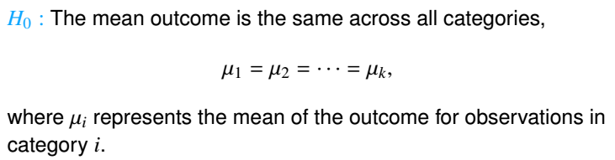

Slide 37
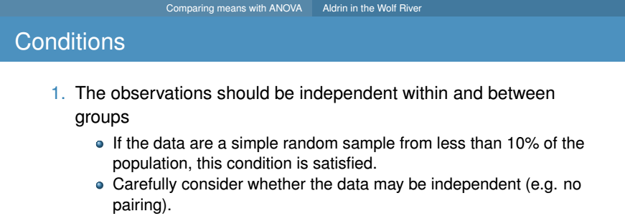
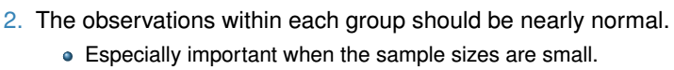
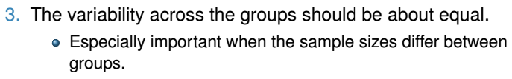

Slide 38

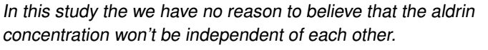

Slide 39

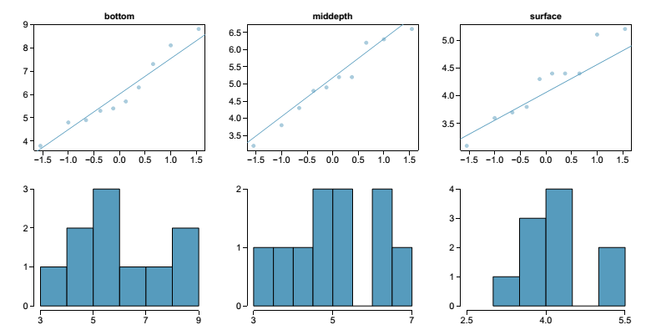

Slide 40

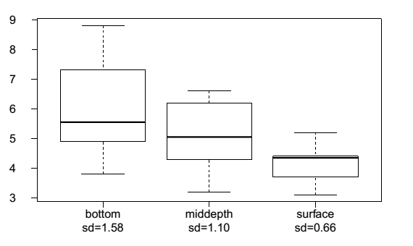

Slide 41
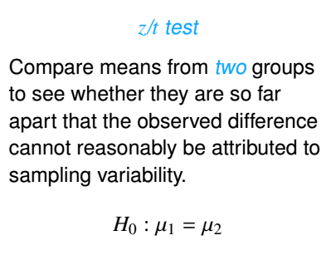
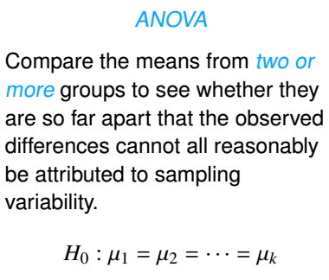

Slide 42
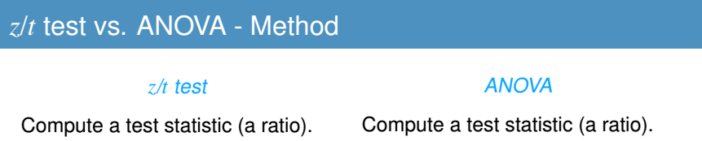
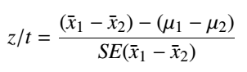
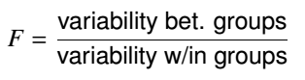

Slide 43
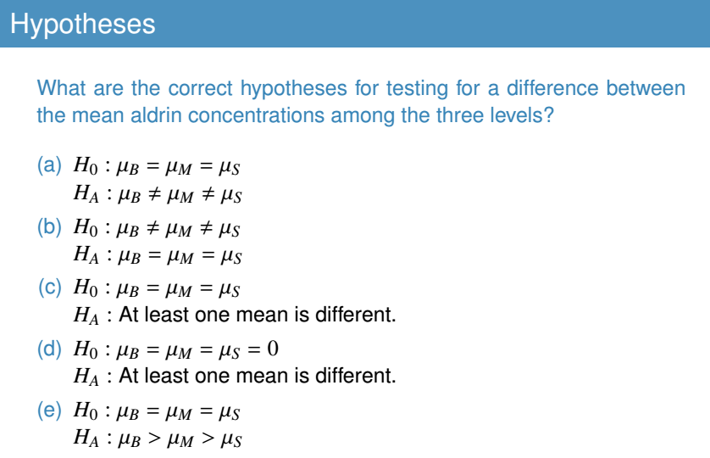

Slide 44
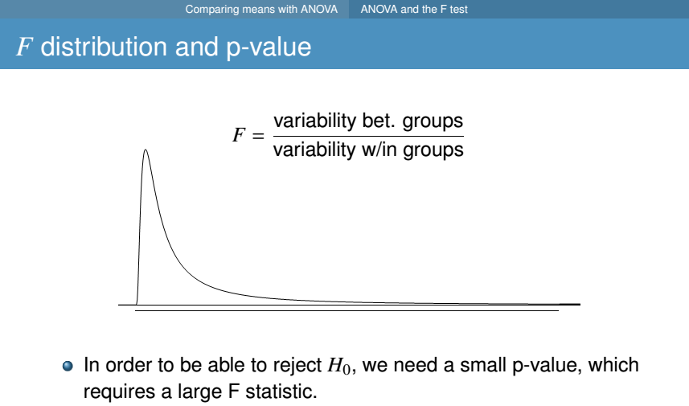

Slide 45
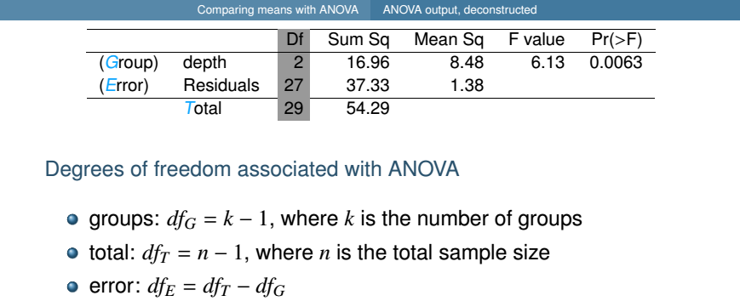
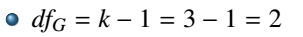
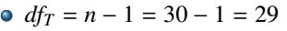
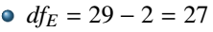

Slide 46


Total variability
2

Slide 47







Slide 48



Slide 49




Slide 50



Slide 51


Computing p-value:
Using R:
pf(6.14, 2, 27, lower.tail = FALSE)
[1] 0.006340096

Slide 52


Slide 53



Slide 54




Slide 55


Slide 56




Slide 57




> pt(1.87, df = 27, lower.tail = FALSE)*2
[1] 0.0723635

Slide 58






> pt(3.81, df = 27, lower.tail = FALSE)*2
[1] 0.0007300288

Slide 59
ANOVA in R
Generic example
Boxplot(data$num.var ~ data$factor)
fit <- lm(data$num.var ~ data$factor)
anova(fit)

Slide 60
Tukey’s post hoc
This post hoc (after analysis) test will compute which of the pairwise comparisons are significant.
Tukey’s in R (generic example)
fit <- aov(data$num.var ~ data$factor)
TukeyHSD(fit)

Slide 61
Linear Regression
- Line fitting, residuals, and correlation

Slide 67
Example 1: Calories per serving size

Slide 68

Modeling Calories
Describe the Association

Slide 69
Modeling Calories
Describe the Association
Strength: Strong

Slide 70
Modeling Calories
Describe the Association
Strength: Strong
Shape: Linear

Slide 71
Modeling Calories
Describe the Association
Strength: Strong
Shape: Linear
Direction: Positive

Slide 72
Correlation Coefficients & Covariance
Covariance: A measure of how much two variables change (linearly) together:

Slide 73

Correlation Coefficients & Covariance
Covariance: A measure of how much two variables change (linearly) together:
Compare to variance of a single variable:

Slide 74


Covariance

Slide 75


Covariance

Slide 76


Covariance

Slide 77

Correlation Coefficients & Covariance
Correlation: (specifically Pearson correlation, r) is a standardized version of cov(X,Y)
Also measures degree of linear relationship
While cov(X,Y) can take any value, r, or cor(X,Y) is always between -1 and 1

Slide 78

Pearson Correlation Coefficient, r
r = 1 perfect linear correlation
r = -1 perfect linear correlation
r = 0 no LINEAR correlation
r says nothing about the “steepness”

Slide 79
Modeling Calories
Describe the Association
Strength: Strong
Shape: Linear
Direction: Positive

Slide 80
Modeling Calories
Describe the Association
Strength: Strong
Shape: Linear
Direction: Positive
Estimate the Correlation

Slide 81
Modeling Calories
Describe the Association
Strength: Strong
Shape: Linear
Direction: Positive
Estimate the Correlation
r = 0.95

Slide 82



Modeling Calories

Slide 83


Modeling Calories
response variable
slope
intercept
explanatory variable

Slide 84


Modeling Calories
response variable
slope
intercept
explanatory variable
y-hat is estimated. Not actual data values
Explanatory variable is not estimated. It represents actual data values.

Slide 85
Modeling Calories
response variable
slope
intercept
explanatory variable

Slide 86

Slope
slope

Slide 87
Slope
slope
rise
run

Slide 88
Interpreting Slope
A food item with 1 more gram of fat is predicted to have 13.8 more calories
An increase in fat by 1 gram corresponds with an increase in calories by 13.8.
NOT: Adding 1 gram of fat causes the calories to increase by 13.8.
rise
run

Slide 89
Modeling Calories
response variable
slope
intercept
explanatory variable

Slide 90

Interpreting the Intercept
intercept

Slide 91

Residuals: How well does it fit?

Slide 92
Residuals: How well does it fit?
Country Pork Sandwich
(48, 1040)
Actual y = 1040
Predicted, ŷ = 111.4 + 13.8(48)
= 773.8
e = 1040 - 773.8 = 266.2
266.2

Slide 93
Residuals: How well does it fit?
-151
Breakfast Bowl
(42, 540)
Actual y = 540
Predicted, ŷ = 111.4 + 13.8(42)
= 691
e = 540 - 691 = -151

Slide 94
Residuals: How well does it fit?
Country Pork Sandwich
Positive Residual ←→ Above the Line ←→ Above average Calories for that amount of Fat
266.2
-151
Breakfast Bowl
Negative Residual ←→ Below the Line ←→ Below average Calories for that amount of Fat

Slide 95

Residuals: How well does it fit?
What’s the variability of y (in this case Calories)?

Slide 96

Residual Plot
A linear model predicts a specific amount of change in y related to change in x: the slope.
Residuals show the variability that is “left over.”
I.e. The variability not accounted for by the line.
Variability in y
Variability in Residuals

Slide 97



Residual Plot
A linear model predicts a specific amount of change in y related to change in x: the slope.
Residuals show the variability that is “left over.”
I.e. The variability not accounted for by the line.
Variability in y
Variability in Residuals

Slide 98
Y variability vs. Residual Variability

Slide 99
R² (Coefficient of Determination)
The strength of the fit of a linear model is most commonly evaluated using R².
R² is the square of the Pearson correlation coefficient, r.
Always between 0 and 1, i.e. 0 ≤ R² ≤ 1
Interpretation:
Measures the amount (percent) of variability in y (the response) that is explained by the model (or by x, the explanatory variable).

Slide 100
R²
R² = 0.90
According to this model, 90% of the variability in calories is explained by variability in grams of Fat.

Slide 101
Inference and Regression in More Detail

Slide 102

Be careful when just given a numerical correlation…
All of these graphs show
a correlation of 0.816
(Anscombe's quartet)

Slide 103







Slide 104



Slide 105



Slide 106


Slide 107


Slide 108




(Optional Formula)

Slide 109



(Optional Formula)

Slide 110


Slide 111


Slide 112


Slide 113


Slide 114



Slide 115


Slide 116

Dangers of Extrapolation
“By 2048, all Americans will be overweight or obese”
http://www.ncbi.nlm.nih.gov/pubmed/18719634
2008 North American Association
for the Study of Obesity
What went wrong?
Prevalence of obesity and overweight among US adults: Observed during 1976–2004 and projected. The projected prevalence presented here are those based on our linear regression models.

Slide 117
Dangers of Extrapolation

Slide 118
Dangers of Extrapolation

Slide 119
Dangers of Extrapolation
Logistic Regression
(See section 8.4 if you are curious)

Slide 120


Slide 121


Slide 122




Slide 123



Slide 124


Slide 125



Slide 126


Slide 127


Slide 128


Slide 129
Hypothesis Testing and Regression

Slide 130
Testing the Overall Model
Question: Does the model explain a significant amount of variability?
Hypothesis: H₀: The model does not provide useful information about the variability of Calories.
H_{a}: The the model provides explanatory power about the variability of Calories
Test Static & p-value: F-statistic
Also look at R².
Call:
lm(formula = Calories ~ Fat.g., data = burger)
Residuals:
Min 1Q Median 3Q Max
-150.93 -47.73 -14.84 24.54 266.28
Coefficients:
Estimate Std. Error t value Pr(>|t|)
(Intercept) 111.3816 11.9237 9.341 6.38e-16 ***
Fat.g. 13.7988 0.4027 34.263 < 2e-16 ***
---
Signif. codes: 0 ‘***’ 0.001 ‘**’ 0.01 ‘*’ 0.05 ‘.’ 0.1
Residual standard error: 71.75 on 120 degrees of freedom
Multiple R-squared: 0.9073, Adjusted R-squared: 0.9065
F-statistic: 1174 on 1 and 120 DF, p-value: < 2.2e-16

Slide 131
Testing the Overall Model
Question: Does the model explain a significant amount of variability?
Hypothesis: H₀: The model does not provide useful information about the variability of Calories.
H_{a}: The the model provides explanatory power about the variability of Calories
Test Static & p-value: F-statistic
Also look at R².
Call:
lm(formula = Calories ~ Fat.g., data = burger)
Residuals:
Min 1Q Median 3Q Max
-150.93 -47.73 -14.84 24.54 266.28
Coefficients:
Estimate Std. Error t value Pr(>|t|)
(Intercept) 111.3816 11.9237 9.341 6.38e-16 ***
Fat.g. 13.7988 0.4027 34.263 < 2e-16 ***
---
Signif. codes: 0 ‘***’ 0.001 ‘**’ 0.01 ‘*’ 0.05 ‘.’ 0.1
Residual standard error: 71.75 on 120 degrees of freedom
Multiple R-squared: 0.9073, Adjusted R-squared: 0.9065
F-statistic: 1174 on 1 and 120 DF, p-value: < 2.2e-16
Conclusion: F is high, the p-value is small, and the R² value is large. Thus we conclude that the model explains a significant amount of variation in Calories.
OR: Fat grams explains a significant amount of the variability in calories.

Slide 132
Testing the Slope (or intercept)
Question: Does the slope in our model indicate a meaningful relationship?
Hypothesis: H₀: 𝜷₁ = 0
(There is no relationship.)
H_{a}: 𝜷₁ ≠ 0
(There is a relationship.)
Test Static & p-value: t-statistic
Call:
lm(formula = Calories ~ Fat.g., data = burger)
Residuals:
Min 1Q Median 3Q Max
-150.93 -47.73 -14.84 24.54 266.28
Coefficients:
Estimate Std. Error t value Pr(>|t|)
(Intercept) 111.3816 11.9237 9.341 6.38e-16 ***
Fat.g. 13.7988 0.4027 34.263 < 2e-16 ***
---
Signif. codes: 0 ‘***’ 0.001 ‘**’ 0.01 ‘*’ 0.05 ‘.’ 0.1
Residual standard error: 71.75 on 120 degrees of freedom
Multiple R-squared: 0.9073, Adjusted R-squared: 0.9065
F-statistic: 1174 on 1 and 120 DF, p-value: < 2.2e-16

Slide 133
Testing the Slope (or intercept)
Question: Does the slope in our model indicate a meaningful relationship?
Hypothesis: H₀: 𝜷₁ = 0
(There is no relationship.)
H_{a}: 𝜷₁ ≠ 0
(There is a relationship.)
Test Static & p-value: t-statistic
Call:
lm(formula = Calories ~ Fat.g., data = burger)
Residuals:
Min 1Q Median 3Q Max
-150.93 -47.73 -14.84 24.54 266.28
Coefficients:
Estimate Std. Error t value Pr(>|t|)
(Intercept) 111.3816 11.9237 9.341 6.38e-16 ***
Fat.g. 13.7988 0.4027 34.263 < 2e-16 ***
---
Signif. codes: 0 ‘***’ 0.001 ‘**’ 0.01 ‘*’ 0.05 ‘.’ 0.1
Residual standard error: 71.75 on 120 degrees of freedom
Multiple R-squared: 0.9073, Adjusted R-squared: 0.9065
F-statistic: 1174 on 1 and 120 DF, p-value: < 2.2e-16
Conclusion: t is high and the p-value is small. We reject the null hypothesis in favor of the alternative, namely the slope 13.8 Cal/g in our model indicates a real relationship among food items.

Slide 134
Testing the Slope (or intercept)
95% CI:
b₁ ± t* x SE
13.7988 ± 4.3 x 0.4027
(12.07, 15.53)
We are 95% confident that the true slope is between 12.07 Cal/g and 15.53 Cal/g
Question: Does the slope in our model indicate a meaningful relationship?
Hypothesis: H₀: 𝜷₁ = 0
(There is no relationship.)
H_{a}: 𝜷₁ ≠ 0
(There is a relationship.)
Test Static & p-value: t-statistic
Also look at S.E: Calculate a CI
b₁ ± t* x SE
(Use df = n - #of predictors - 1)
Call:
lm(formula = Calories ~ Fat.g., data = burger)
Residuals:
Min 1Q Median 3Q Max
-150.93 -47.73 -14.84 24.54 266.28
Coefficients:
Estimate Std. Error t value Pr(>|t|)
(Intercept) 111.3816 11.9237 9.341 6.38e-16 ***
Fat.g. 13.7988 0.4027 34.263 < 2e-16 ***
---
Signif. codes: 0 ‘***’ 0.001 ‘**’ 0.01 ‘*’ 0.05 ‘.’ 0.1
Residual standard error: 71.75 on 120 degrees of freedom
Multiple R-squared: 0.9073, Adjusted R-squared: 0.9065
F-statistic: 1174 on 1 and 120 DF, p-value: < 2.2e-16
> qt(0.975, 120)

Slide 135
Regression in R

Slide 136
Multiple Linear Regression
Many variables in a model Adjusted R²

Slide 137


Slide 138


Slide 139

Weights of 80% of the books can be predicted accurately using this model.
For 10 cm³ increase in volume of books, the weight is expected to increase by 7g on average.
(c) The correlation between weight and volume is R = 0.80² = 0.64.
(d) The model underestimates the weight of the book with the highest volume

Slide 140


Slide 141


Slide 142
When doing regression in R if a variable is a factor (i.e. it is categorical and it is stored as a “factor” in R) then most linear model functions will automatically create dummy variables:
 | Category Applies
Category | Yes | No
A | 1 | 0
B | 1 | 0
... | ... | ...

Slide 143


Slide 144

In this case, R has chosen hardcover as the reference, so
x_{cover}= 0 if it’s hardcover and 1 if it’s paper back

Slide 145


Slide 146




Slide 147


Slide 148


Slide 149


Slide 150


Slide 151



Slide 152

Children whose moms haven’t gone to HS, did not work during the first three years of the child’s life, have an IQ of 0, and are 0 yrs old are expected to score 19.59.
This intercept does not make sense in context. It’s meaningless

Slide 153


Slide 154

Collinearity (correlation) between predictors
If predictors are highly correlated with each other
They both try to explain the same variability in the response.
They can make slopes uncertainty.
If predictors are highly correlated, don’t include both in your model.

Slide 155


Slide 156



Slide 157




Slide 158


Slide 159



Slide 160


Slide 161




Slide 162





Slide 163



Slide 164



Slide 165
Model selection
Identifying significance Model selection methods

Slide 166

Hamermesh & Parker. (2004)“Beauty in the classroom: instructors’ pulchritude and putative pedagogical productivity˜ Economics Education Review.

Slide 167


Slide 168


Slide 169



Slide 170


Slide 171


Slide 172



Slide 173


Slide 174


Slide 175


Slide 176


Slide 177


Slide 178






Slide 179


Slide 180


Slide 181
Checking model conditions using graphs

Slide 182


Slide 183


Slide 184


Slide 185



Slide 186


Slide 187


Slide 188


Slide 189
Multiple Regression in R

Slide 190
Multiple Linear Regression
Many variables in a model Adjusted R²

Slide 193
Weights of 80% of the books can be predicted accurately using this model.
For 10 cm³ increase in volume of books, the weight is expected to increase by 7g on average.
(c) The correlation between weight and volume is R = 0.80² = 0.64.
(d) The model underestimates the weight of the book with the highest volume

Slide 196
When doing regression in R if a variable is a factor (i.e. it is categorical and it is stored as a “factor” in R) then most linear model functions will automatically create dummy variables:
 | Category Applies
Category | Yes | No
A | 1 | 0
B | 1 | 0
... | ... | ...

Slide 198
In this case, R has chosen hardcover as the reference, so
x_{cover}= 0 if it’s hardcover and 1 if it’s paper back

Slide 204
Another Example
With a mix of regressors

Slide 207
Children whose moms haven’t gone to HS, did not work during the first three years of the child’s life, have an IQ of 0, and are 0 yrs old are expected to score 19.59.
This intercept does not make sense in context. It’s meaningless

Slide 209
Collinearity (correlation) between predictors
If predictors are highly correlated with each other
They both try to explain the same variability in the response.
They can make slopes uncertainty.
If predictors are highly correlated, don’t include both in your model.

Slide 220
Model selection
Identifying significance Model selection methods

Slide 221
Hamermesh & Parker. (2004)“Beauty in the classroom: instructors’ pulchritude and putative pedagogical productivity˜ Economics Education Review.

Slide 228
(b) is the best answer.
We can also interpret the p-value like this:
Under the null hypothesis (that there is no relation between predictors and response) it is unlikely that we would see a slope “this extreme” or more.

Slide 236
Checking model conditions using graphs

